Slide 1

Welcome To Our Presentation

Slide 2
Title
The Concept of Abusive Content Free Social Media in Perspective of Bangladesh

Slide 3
Group Members
Nazia Majadi, Syful Islam, M.H. Kabir
¹PhD Student/Researcher, School of ICT Griffith University, Brisbane Queensland, Australia
²⁻³Dept of CSTE, Noakhali Science and Technology University, Noakhali-3814, Bangladesh

Slide 4
Outline
Abstract
Objectives
What is Social media?
Social media in Bangladesh
Some serious occurrence's
Proposed System model
Architecture of the proposed system model
Performance analysis
Recommendation
Comparison
Future Work

Slide 5
Abstract
Nowadays the utilization of social media has spread all over the world including Bangladesh. But at present time many abusive contents sharing (i.e., public post, photos or videos in Facebook or online blog) are increasing at an alarming rate.
It raises the possibility of engaging in feud between nations, hurts the feeling of religious people, mislead the young generation etc.
Usually general people do not know how to stop the visibility of these types of abusive contents.
In this paper we are going to propose a system model, that is arranged in such way that it is capable of receiving complaints with the link of that abusive content, synthesis the whole document into words, check it whether it is abusive or not by comparing the containing words with our system’s abusive word dictionary, verify its importance count the total frequency of complaints for that particular links and take necessary action.

Slide 6
Primary Research Objective
Detecting Fake user accounts
Forcing user to use proper identity
Analyse the abusive contents
Obtain the drawbacks of social media.
Make suggestion to overcome the drawbacks.
Propose a system model that will capable of identifying and removing any particular link or id without the stopping the whole site

Slide 7
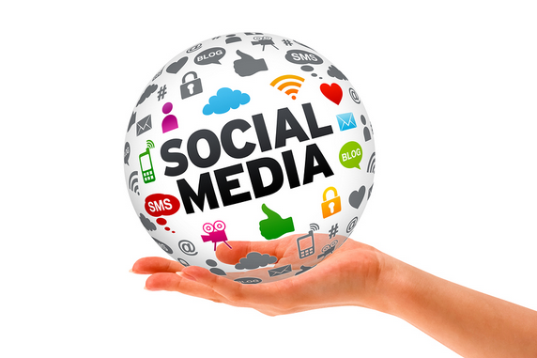
What is social Media?
Social media refers to interaction among people in which they create, share, and/or exchange information and ideas in virtual communities and networks.

Slide 8
Social media in Bangladesh
The Internet in Bangladesh has witnessed phenomenal growth in 2015-16.Now, internet users of Bangladesh are more than 54.658 million.
The popularity of social media is increasing tremendously day by day in our country and sometimes it plays a vital and more effective role like mainstream media.
Through these social networks and blogs people attain entertainment, highlight some important news and views.
Moreover, social media site have now become one of the main tools of flourishing democracy as users of it constructively criticize and discuss some vital national, political, religious and sports related issues

Slide 9
Some Serious Occurrence's
The mobs destroyed 22 Buddhist temples and monasteries and 50 houses in reaction to a tagging of an image depicting the desecration of a Quran on the timeline of a fake Facebook account under the Buddhist male name.
An abusive video on the Prophet Mohammad was uploaded on the site and Google Inc. that owns the website did not delete it, creating tensions.
Bloggers have raised questions about religious faith - all faiths - and the role of religion in society, and have been critical of extremism and militancy. And Bangladesh has seen the fourth murder of a blogger

Slide 10
Steps Taken by BD Govt.
Thegovernment has amended the ICT Act 2006 to incorporate a provision of 14 years’ jail term for posting objectionable materials on the internet but despite these problems remain unsolved.
The Bangladesh Telecommunication Regulatory Commission has taken up a costly project to make the internet “safe” – especially in the wake of probable political confrontations – by filtering data at internet gateways and different social media sites, even news websites, which, many said, would hamper the free flow of information.
But, BTRC is not currently well-equipped to conduct the high-level monitoring.So, through newly adapted project’s technologies BTRC will shut down any website using if it found material that spread social, political and religious hatred.

Slide 11
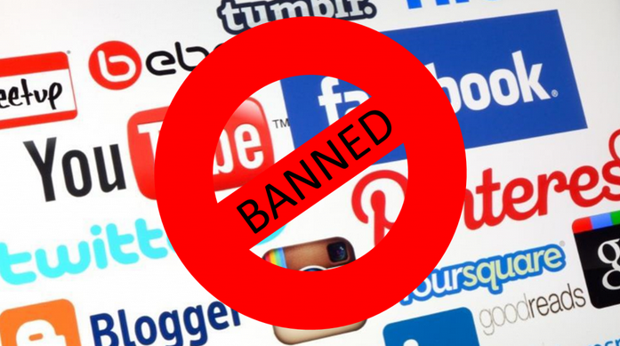
Consequent Result

Slide 12
Related Research & Articles
“Rights activists fear potential abuse of anti-terrorism law” where they discussed about the challenges of privacy and security in Bangladesh.
“BTRC project to filter social media, news sites for ‘safe’ internet”, here the activities of the BTRC(Bangladesh telecommunication Regulatory Commission) about the process of filtering social media contents
“Effective cyber law needed to control abuse of social media”- discussed about the legal steps about the abusive contents.
“Social media coming under watch” discuss about supervision of social media by BTRC.

Slide 13
Proposed System Model
Our system model is based on
detecting fake account,
forcing the user to use the real identity &
reporting the offensive content in the social media.
The whole system comprises of two users: 1) Who Report the Complain
2) Database Management Authority

Slide 14
Filtering User Account
Fake accounts are one of the main reason of abusive contents in social media. Our proposed system will force the users in social media to use real identities.
If the user account contains proper identity, the user will be proceeded to post on his/her website wall.
If not, the user account will be pended to post on the wall and detected as a malicious user. Then the system will automatically notify them to user proper identity to prevent from being suspended.
if a new user wants to be added and age less than 18, the user must be recommended be an existing user with proper identity

Slide 15
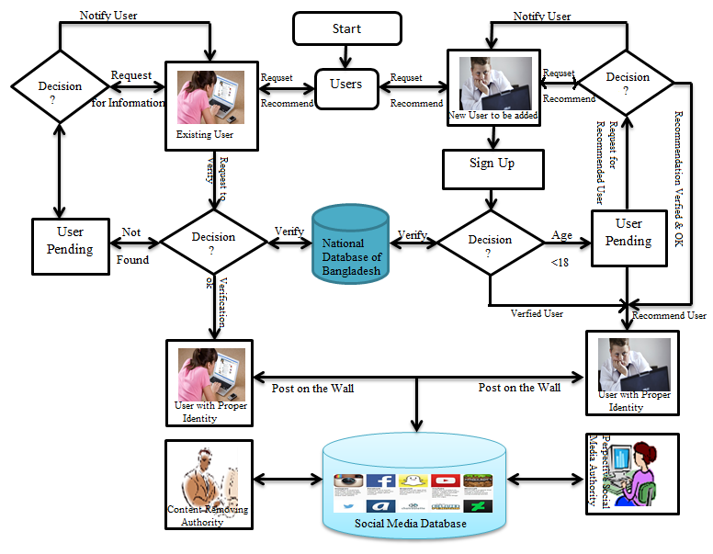
Flow diagram of the proposed system for controlling abusive content

Slide 16
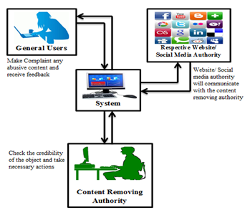
Architecture of the proposed system

Slide 17
Reporting the abusive content
After seeing abusive post the subscriber of the social media will copy the link of that abusive content.
Then He/she will enter into our proposed system and paste that link in the mentioned box. Then he has to write a description why he thought that the content is offensive. Finally the reported complains will be saved in the system Database.
Here one thing should be mentioned that only Bangladeshi IP holder can report their complaints in our system model and one subscriber can report a particular link for only once.

Slide 18
Synthesize and Comparison
Any report recorded at database will be synthesized into words. Then our system will try to recognize the word is matched with our keyword or not.
If it gets any keyword saved in our system’s record book then it will started matching the other words rather than the keyword with the abusive words of system model’s dictionary.
If it also found then system will identify the content as abusive one and put it’s to the complained table along with the IP of the subscriber who reports against it.

Slide 19
Counting the frequency and weight of the report
In our system model the reported content’s link and the reporter’s id will be accumulated in a table. When a particular link is being received it will be flagged as 1 otherwise it will be 0.
After receiving another complaint it will match with flag 1 and 0. If it is 0, it will be saved in one row below of the previous link and will be flagged as 1.
We will be able to count how many time a specific link in being complained by its adjacent IPs’ frequencies as one IP is capable of reporting only once for that link. When any link is being complained for many times (say 100) it will be topped in the table and will be highlighted.

Slide 20
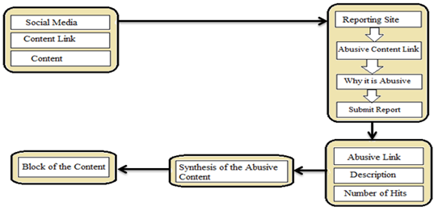
Steps of the whole procedure

Slide 21
Recommendation
For our proposed system, it may require to make agreement with the social media.
The respective authority for this system should be neutral in terms of political and region.
Authority should have the power of realizing the sensitivity and importance of the reported content.
The freedom of speech must be ensured and the authority should have good consideration power.
They should be much efficient and the response against any complaint should be quick enough.

Slide 22
Comparison between proposed and existing System
Name Properties | Exsisting System | Proposed System
Local Control on Social Media | Partial control by closing social media temporarily | Full Control on social media
Fake Account Detection? | Partial Control | Full Control
User Anonymity | No Control | Full Control
Abusive Content Control? | Partially but not very responsive | Full Control but agreements required with social media

Slide 23
Any Question Please
?

Slide 24
Thanks for patience

